Slide 1
SYEZD 2014
13th ALL-DIASPORA YOUTH CONFERNCE
SAN FRANCISCO, USA

Slide 2
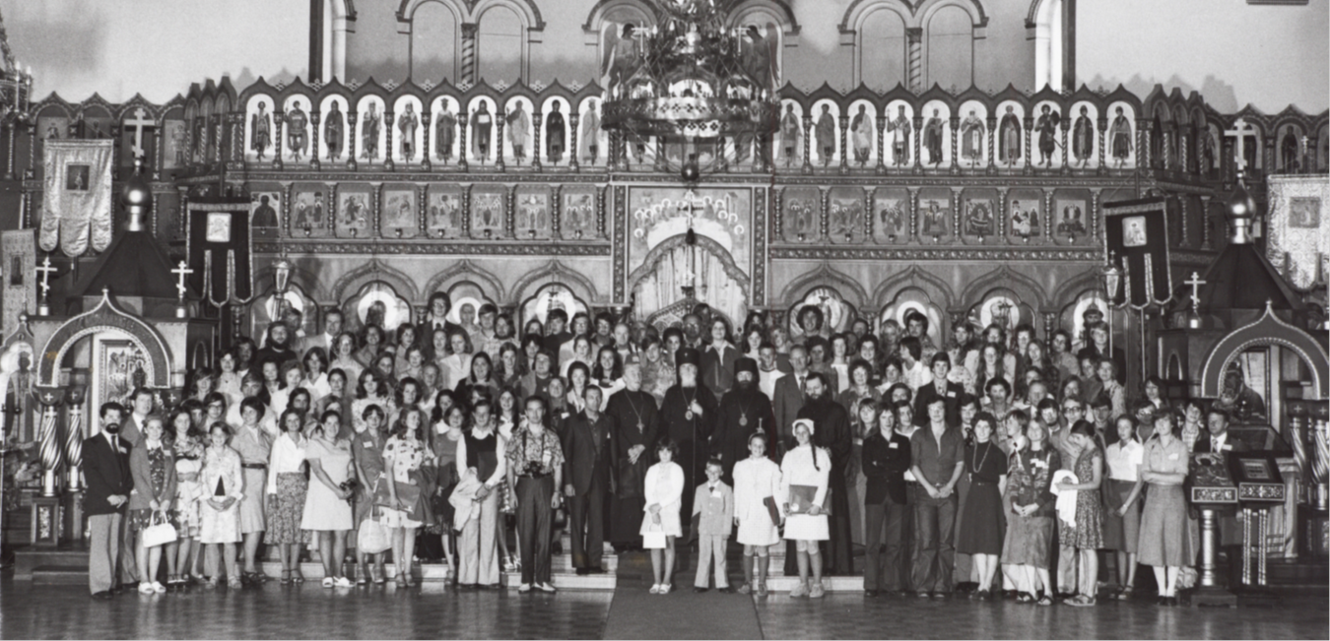
The All-Diaspora youth conferences have a 40 year tradition

Slide 3
The XII All-Diaspora youth conference in Paris had
150 representatives from
AMERICA, AUSTRALIA, GERMANY, AUSTRIA, BELGIUM, FRANCE, RUSSIA, UKRAINE, BELORUSSIA, KAZAHSTAN, POLAND AND MOLDOVIA ALL FROM 28 DIOCESE

Slide 4
XIII All-Diaspora Youth Conference
June 27- July 4, 2014
Purpose: To study missionary service in the field of social service, charity and volunteer work with the intent of spreading this work to a local parish level.
Conference motto- “In the footsteps of St. John of Shanghai and San Francisco.”
The forum will be devoted to missionary work in the field of philanthropy and will be held during the All-Council of Bishops of the Russian Orthodox Church Abroad and the celebrations to mark the 20th anniversary of the glorification of St. John of Shanghai and San Francisco.

Slide 5
CONFERENCE PROGRAM
Will include
Partcipation in divine services, dedicated to the celebration of the feast of st. John of Shanghai and San Francisco.
Lectures, group discussion and workshops.
Reports and visits to local: Orthodox nursing homes and hospitals, soup kitchens and low income food providers.
Round table discussions with participation of the members of the All-Council of Bishops (R.O.C.O.R.)
Meeting with the U.S. General Consul of the Russian Federation in San Francisco Sergei Vladimirovich Petrov.
Workable plans and projects on the subject «Volunteer services at the parishes».

Slide 6
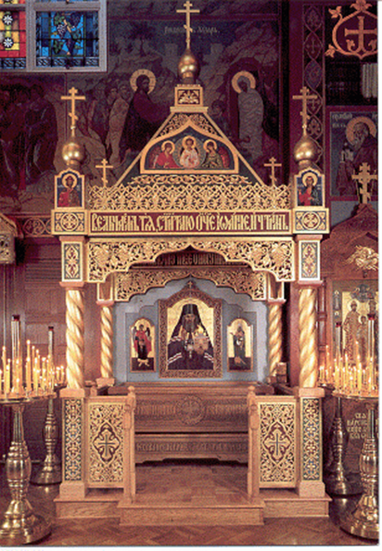
PILGRIMAGE AND CULTURAL PROGRAM
Visiting parishes around the Bay Area.
Bus tour expedition of
San Francisco.
A trip to the Russian fortress Fort-Ross, on the Pacific ocean.
Visit «Russian Center»
Concert given by the conference participants and local cultural performers, farewell banquet dinner.

